Slide 1

OBJECT ORIENTED PROGRAMMING THROUGH C++
PROJECT REVIEW 1&2
STUDENT RECORD MANAGER USING C++
PRESENTED BY
K Hemanth Sai Venkata Vidya Sagar (25B11AI494)
B Ganesh (25B11AI084)
G Sai (25B11AI320)
A Keerthu Praveen (26B21AI132)
GUIDED BY
T. Vijaya Lakshmi
Assistant Professor
DEPARTMENT OF
ARTIFICIAL INTELLIGENCE AND MACHINE LEARNING

Slide 2



Contents
Abstract
Introduction
Problem Statement
Objectives
Modules and Functions
Implementation
C++ Concepts Used
Inputs
Expected Outputs
Flowchart
Team Contribution
Conclusion
References

Slide 3
Abstract
The Student Record Manager is a C++ application designed to store, manage and analyze student records in an organized way. It uses arrays to hold student data and Object-Oriented Programming concepts such as classes, objects, constructors and member functions to keep data and operations together. The system allows the user to add student details, display all records, and search for a particular student using roll number or name. It also analyzes marks by finding the highest marks, lowest marks and average marks of the class. String handling operations are used to format and compare student names. The project provides a simple, menu-driven and efficient way to manage student information while demonstrating arrays, searching, string handling and OOP concepts in C++.

Slide 4
Introduction
Student information such as roll number, name, section and subject marks is needed every day in a department. When this data is written on paper or kept in separate lists, it becomes difficult to update, search and compare. The Student Record Manager solves this by storing each student as an object of a class, so that the details and the operations on them stay together in one place.
The system is developed in C++ using classes and objects, arrays of objects, strings and functions. An array holds many student records at once, and a menu-driven interface lets the user add records, display them, search for a student and analyze marks easily from the console.

Slide 5
Problem Statement
Managing student records manually becomes difficult as the number of students increases. Writing every student's details, searching for one particular student, and finding the highest, lowest and average marks by hand takes a lot of time. Records can be entered wrongly, names can be written in different styles, and data can be mixed up or lost.
The proposed Student Record Manager solves these problems by providing a C++ application in which student details are stored in an array of objects. The user can add and display records, search for a student by roll number or name, and get the highest, lowest and average marks automatically. Names are handled using string operations to keep the data neat and consistent.

Slide 6
Objectives
To develop a C++ based Student Record Manager using classes and objects.
To store student details and marks in an array of objects.
To add and display student records in a clear, formatted way.
To search for a student using roll number or name.
To find the highest and lowest marks in the class along with the student names.
To calculate the average marks of each student and of the class.
To perform string handling operations such as formatting, case conversion and comparison on student names.
To validate the input so that wrong roll numbers and marks are not accepted.
To provide an easy-to-use menu-driven interface.

Slide 7
Modules &Functions
2. Student Manager Class
1. Student Class
Stores roll number, name, section and marks
Data members are private (encapsulation)
Constructor initialises a new student
Input and display of one student
Average marks of one student
Holds the array of Student objects
Keeps a count of students stored
Adds a new student to the array
Displays all students
Prevents adding beyond the array size
Functions:
Student() (constructor)
input()
display()
getAverage()
getRoll(), getName()
Functions:
addStudent()
displayAll()
getCount()

Slide 8
Modules &Functions
4. Marks Analysis Module
3. Search Module
Search by roll number
Search by name (not case-sensitive)
Displays the full record if found
Shows "Student not found" otherwise
Finds the highest marks and the student
Finds the lowest marks and the student
Calculates each student's average
Calculates the class average
Functions:
findHighest()
findLowest()
calculateAverage()
classAverage()
Functions:
searchByRoll()
searchByName()

Slide 9
Modules &Functions
5. String Handling Module
6. Menu Module
Converts names to upper case
Formats names in a uniform style
Compares names ignoring case
Finds the length of a name
Displays the list of options
Reads the user's choice
Calls the matching function
Repeats until the user exits
Functions:
toUpperCase()
formatName()
compareNames()
nameLength()
Functions:
showMenu()
main()

Slide 10
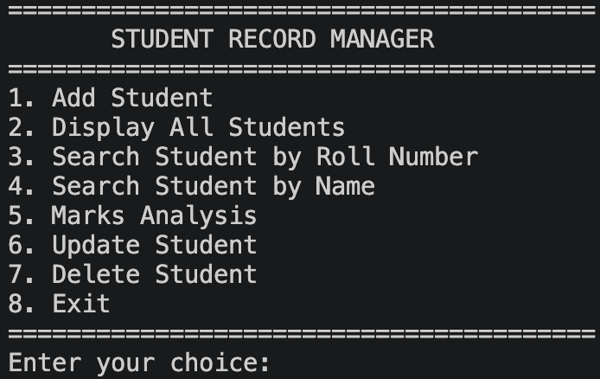
Implementation
Developed using C++ and Object-Oriented Programming concepts.
Created the Student class with private data members and public
member functions.
Used constructors to initialise student objects.
Created the StudentManager class to store student objects in an
array.
Implemented adding and displaying student records.
Implemented search by roll number and by name.
Implemented highest, lowest and average marks calculation.
Implemented string handling operations on student names.
Added input validation for roll numbers and marks.
Integrated all modules through a menu-driven main() function.
Tested the program using sample student records.

Slide 11
C++ Concepts Used
Object-Oriented Programming
Classes and Objects
Encapsulation
Constructors
Member Functions
Access Specifiers (private/public)
Array of Objects
Other C++ Concepts
Arrays
Strings
Functions
Loops
Conditional statements (if, switch)
Input Validation
Header files (<iostream>, <string>, <iomanip>)

Slide 12
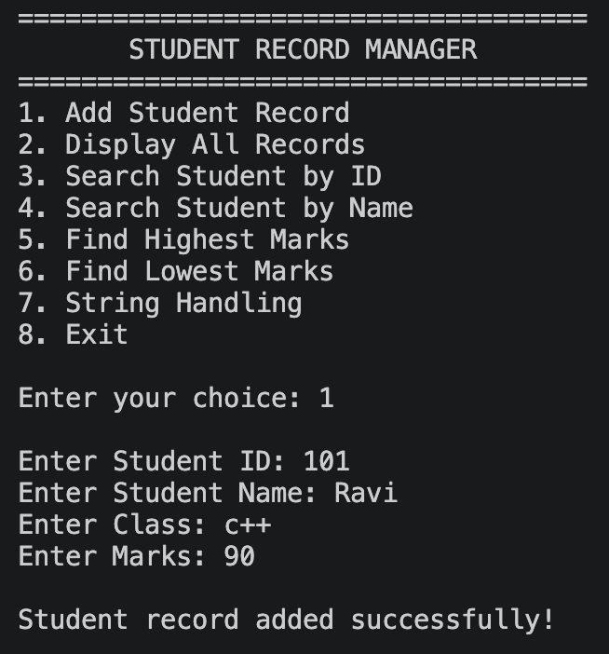
Inputs
Student Details
Roll Number
Name
Section
Gender
Mobile Number
Email
Address
Marks Details
Number of subjects
Marks in each subject
Other Inputs
Roll number to search
Name to search
Menu choice

Slide 13
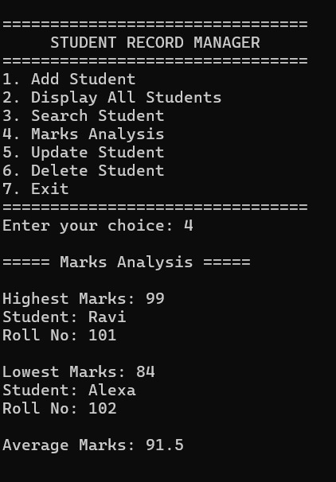
Expected Outputs
Confirmation that a student is added
List of all student records in table form
Full details of a searched student
"Student not found" message when there
is no match
Name in the formatted style
Length of the name
Total marks of each student
Average marks of each student
Highest marks with the student's name
Lowest marks with the student's name
Class average marks
Error messages for invalid input
Menu displayed again after every operation

Slide 14
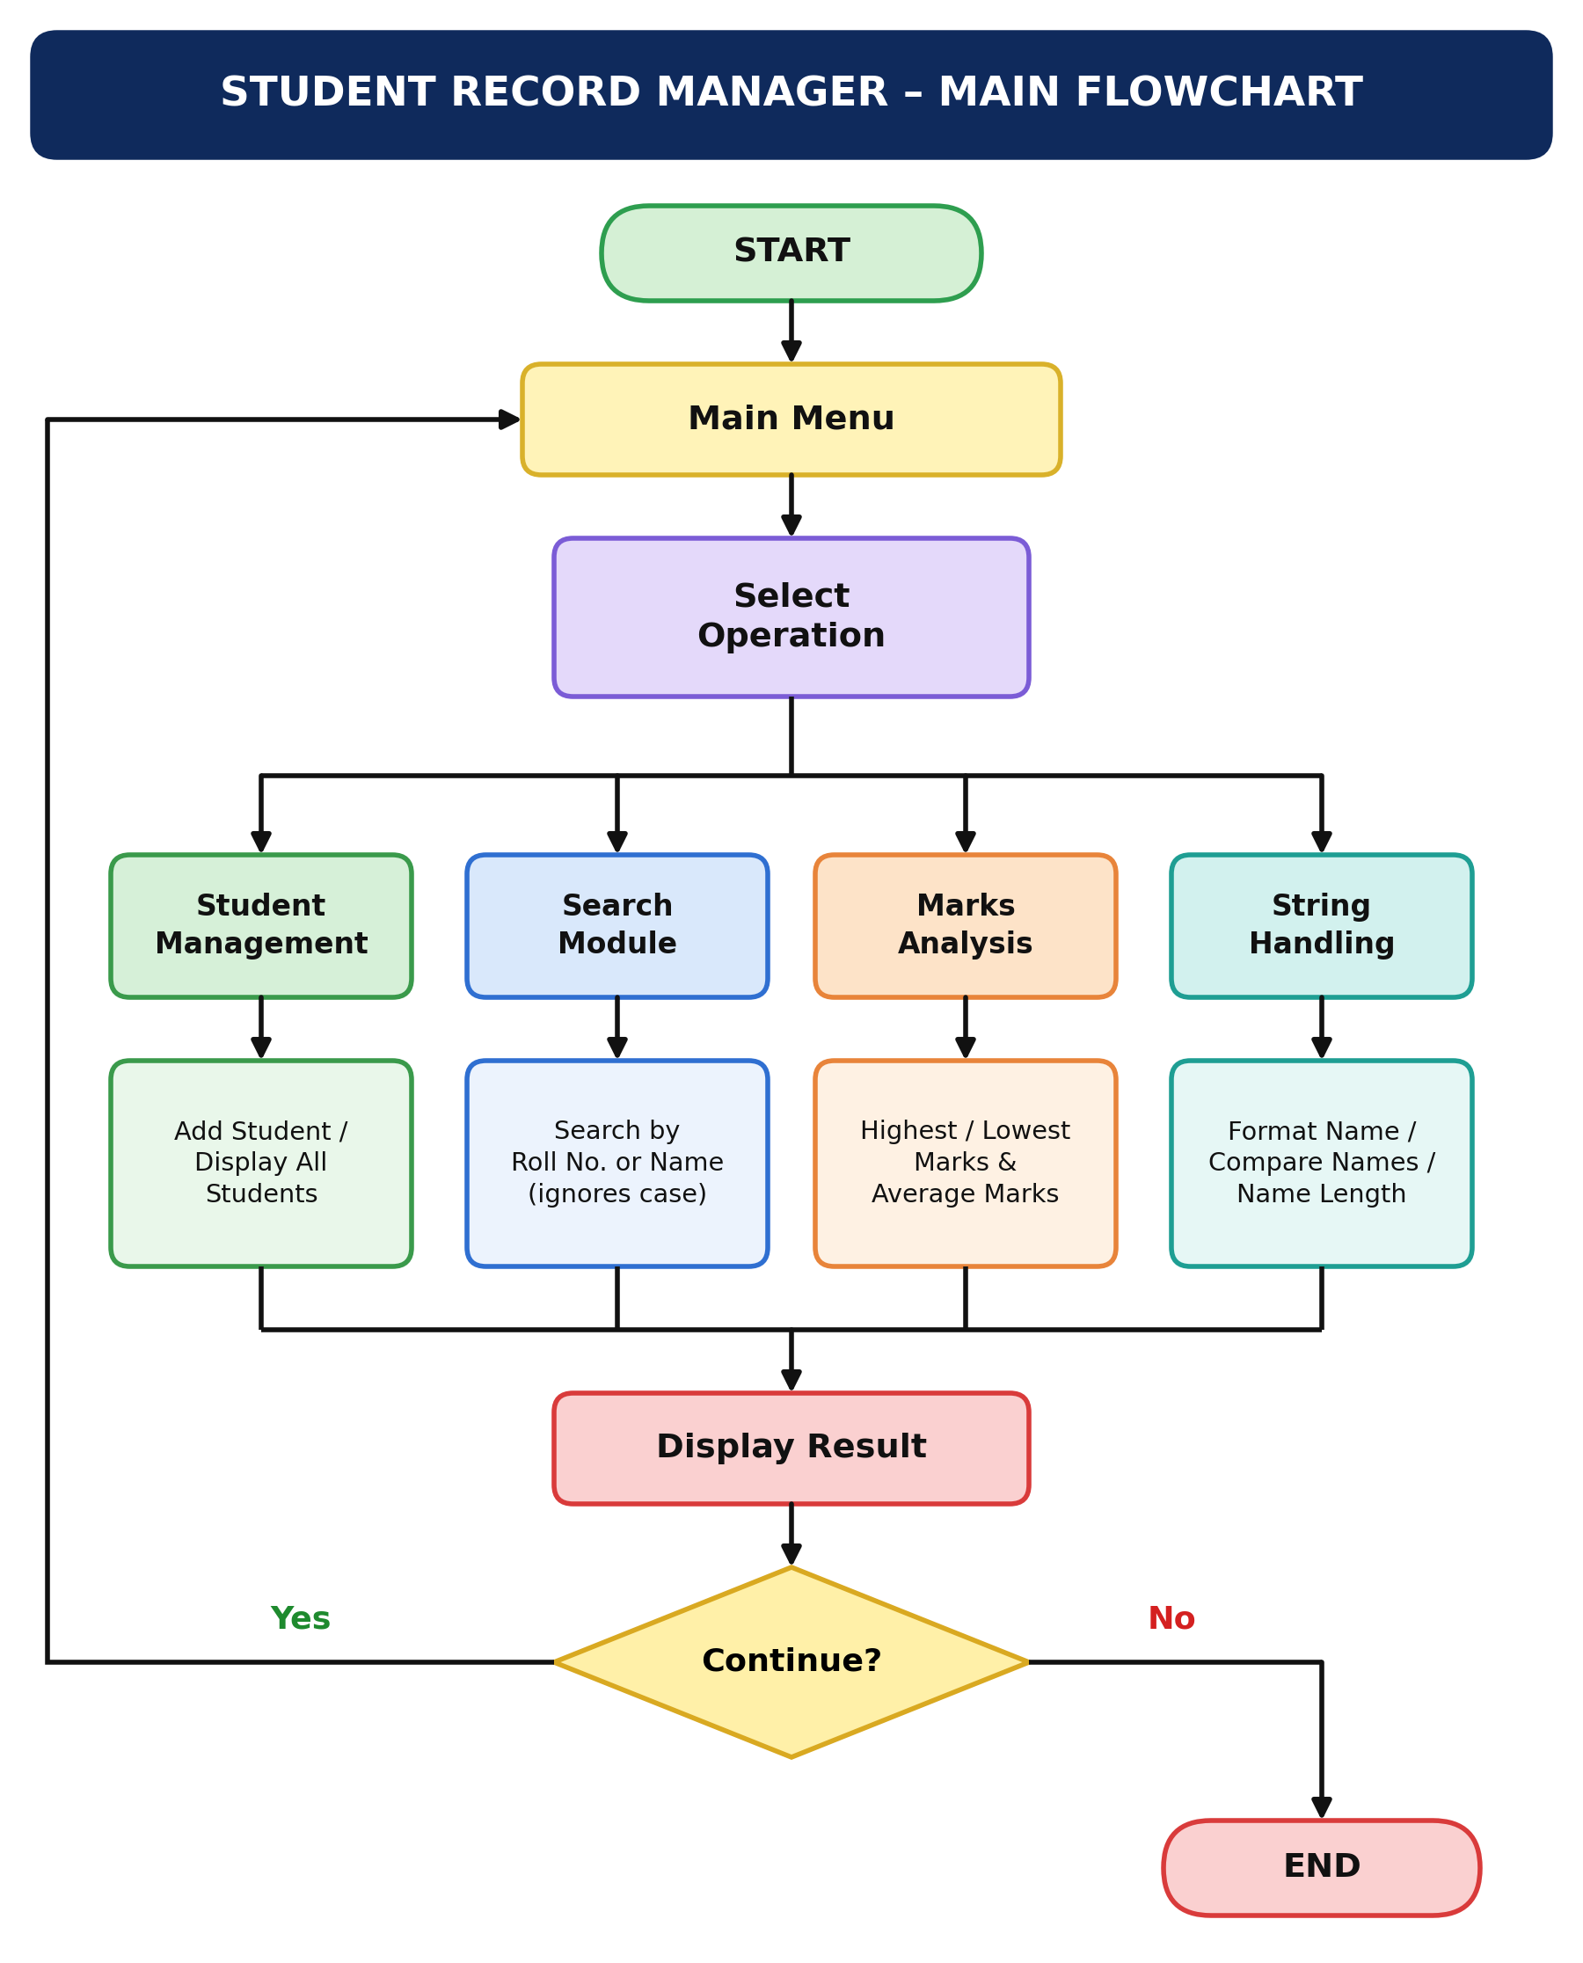

Slide 15
Team Contributions
Roll No. | Team Member | Contribution
25B11AI494 | K Hemanth Sai Venkata Vidya Sagar | OOP Class Design & Student Management
25B11AI084 | B Ganesh | Student Data & Marks Management
25B11AI320 | G Sai | Search, Marks Analysis & Testing
26B21AI0132 | A Keerthu Praveen | Documentation, PPT & Presentation

Slide 16
Conclusion
To conclude, our project has moved from the planning stage to a working implementation of the Student Record Manager.
At this stage, we can add student details, store them in an array of objects, display all records and search for any student by roll number or name.
We have also implemented marks analysis to find the highest, lowest and average marks, and string handling to keep student names neat and consistent.
The remaining work will focus on improving the interface, adding more validation and further testing.
Overall, this project helped us apply classes, objects, arrays and strings in a practical program instead of using them only as separate concepts.

Slide 17
Thank You

